Slide 1


#DOMESTIC VIOLENCE AGAINST WOMAN
SEPTEMBER 30, 2021
AYITI ANALYTICS.- FINAL PROJECT
COHORT MAY-SEPTEMBER 2021

Slide 2
REPORT CONTENTS
01
INTRODUCTION
02
GOALS OF THE PROJECT
Problem
Goals
03 METHODOLOGY
04
EDA
Describing the process of the project
Providing insight about the data
05
MODEL
06 RECOMMENDATION
Choice of the model

Slide 3
GOALS
TO STUDY THE FACTORS THAT ARE RELATED TO DOMESTIC VIOLENCE.
the profiles of the victims in order to bring a solution of sensitization to the agressors and to eradicate domestic violence.

Slide 4
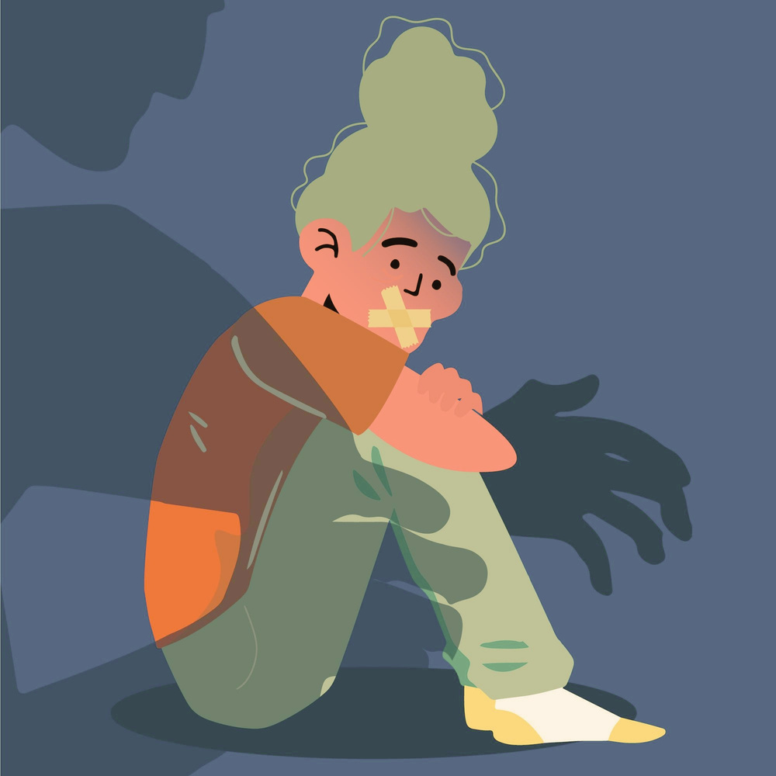
BACKROUND
FOR EVERY 1,000 WOMEN BETWEEN THE AGES OF 15 AND 19, 150 OF THEM HAVE AT LEAST BEEN VICTIMIZED IN HAITI, THE HIGHEST PROPORTION OF ANY OTHER AGE GROUP..

Slide 5

THE PROBLEM
DETERIORATION OF THE QUALITY OF LIFE
THESE CONSEQUENCES OF DOMESTIC VIOLENCE ARE PROBLEMS TO WHICH OUR PROJECT WANTS TO TRY TO FIND A SOLUTION.
ATTEMPTED
MURDER
INTERRUPTION OF DAILY ACTIVITIES
PERPETUATION OF WOMEN'S LOW STATUS AND POVERTY

Slide 6

AUDIENCE
•All young women and girls
•Associations working against violence against woman
•The different institutional and associative partners

Slide 7
DATA SOURCE
DATA WERE COLLECTED ON EMMUS –VI (2016-2017)
(Survey on Mortality, Morbidity and service utilization in Haiti) among 9795 people in Haïti.

Slide 8





METHODOLOGY
1
3
CLEANING
AND ANALYSIS
RECOMMENDATION
Cleaning data and EDA using Python and Pandas and Numpy
Propose recommendation to the different organizations defending women’s rights or fighting against domestic violence.
2
MODELING
Building a Machine Learning Classification Model with Python

Slide 9
QUESTION OF RESEARCH
●What is the profiles of women who are victims of violence?
●How can woman victims of domestic violence be accompanied?
.

Slide 10
RESULTS : GRAPH & COMMENTS
Vodooist
19.1
WOMEN WHO ARE VOODOOISTS, NO RELIGION, OTHER ARE MUCH MORE VICTIMS OF DOMESTIC VIOLENCE.
No religion
16.4
G1
Other
15,4
Catholic
9.6
WE CAN ALSO SEE THAT THE VOODOOISTS AND THE OTHERS ARE 2 TIMES MORE VICTIMS THAN THE CATHOLICS AND THE PROTESTANTS.
Protestant
6.8
0
5
10
15
20
Religion distribution en %
target=Yes

Slide 11
RESULTS: GRAPH & COMMENTS
Ouest
Ouest
Ouest
Ouest
Ouest
Ouest
Ouest
Ouest
12.6
Nord
Nord
Nord
Nord
Nord
Nord
Nord
Nord
12.5
Artibonite
Artibonite
Artibonite
Artibonite
Artibonite
Artibonite
Artibonite
Artibonite
11.5
Centre
REGARDING TO THE FIRST 3 REGIONS, WOMEN WHO ARE FROM THE WEST, NORTH, ARTIBONITE, ARE MUCH MORE VICTIMS OF DOMESTIC VIOLENCE.
Centre
Centre
Centre
Centre
Centre
Centre
Centre
11.1
Nippes
Nippes
Nippes
Nippes
Nippes
Nippes
Nippes
Nippes
9.0
G2
Grand-Anse
Grand-Anse
Grand-Anse
Grand-Anse
Grand-Anse
Grand-Anse
Grand-Anse
Grand-Anse
8.9
Rest-Ouest
Rest-Ouest
Rest-Ouest
Rest-Ouest
Rest-Ouest
Rest-Ouest
Rest-Ouest
Rest-Ouest
8.1
8.1
Nord-Ouest
Nord-Ouest
Nord-Ouest
Nord-Ouest
Nord-Ouest
Nord-Ouest
Nord-Ouest
Nord-Ouest
7.6
Sud-Est
Sud-Est
Sud-Est
Sud-Est
Sud-Est
Sud-Est
Sud-Est
Sud-Est
7.6
Nord-Est
Nord-Est
Nord-Est
Nord-Est
Nord-Est
Nord-Est
Nord-Est
Nord-Est
7.5
Sud
Sud
Sud
Sud
Sud
Sud
Sud
Sud
7.0
0
0
0
0
0
0
0
0
5
5
5
5
5
5
5
5
10
10
10
10
10
10
10
10
15
15
15
15
15
15
15
15
Region distribution en %
target=Yes

Slide 12
RESULTS: GRAPH & COMMENTS
Household and domestic
IN TERMS OF OCCUPATION, WOMEN WHO ARE HOUSEHOLD AND DOMESTIC, NOT WORKING AND SALES ARE MORE VICTIMS OF DOMESTIC VIOLENCE.
Household and domestic
Household and domestic
16.0
Not working
Not working
Not working
12.1
Sales
Sales
Sales
10.2
Agriculture- self employed
Agriculture- self employed
Agriculture- self employed
9.3
G3
Skilled manuel
Skilled manuel
Skilled manuel
9.2
WE CAN ALSO SEE THAT THIS IS THE HIGHEST PROPORTION COMPARED TO THE OTHER OCCUPATION GROUPS.
Professional/technical/managerial
Professional/technical/managerial
Professional/technical/managerial
5.2
Unskilled manuel
Unskilled manuel
Unskilled manuel
4.9
Other
Other
Other
0
0
0
5
5
5
10
10
10
15
15
15
20
20
20
Occupation (grouped) distribution en %
target=Yes

Slide 13
RESULTS: GRAPH & COMMENTS
Primary
12.8
Secondary
9.0
WOMEN OF PRIMARY, SECONDARY, AND NO EDUCATION LEVEL ARE 3 TIMES MORE BEATEN COMPARED TO THOSE OF HIGHER EDUCATION LEVEL.
G4
No education
7.9
Higher
2.8
0
5
10
15
Educational level distribution en %
target=Yes

Slide 14
RESULTS: GRAPH & COMMENTS
15-19
15.0
20-24
12.1
25-29
9.4
30-34
7.1
G5
35-39
WOMEN WHO ARE IN THE AGE GROUP 15-19, 20-24 AND 25-29 ARE THE MOST BEATEN.
7.0
40-44
6.9
45-49
6.6
50-54
6.5
55-59
6.4
60-64
4.8
0
5
10
15
Age in 5-year groups distribution en %
target=Yes

Slide 15
RESULTS: GRAPH & COMMENTS
8
7.3
6
5.8
4
G6
AMONG THE WOMEN WHO ARE VICTIMS OF VIOLENCE, THE WOMEN WHO DO NOT WORK ARE MORE BEATEN WHEN THEY GO OUT WITHOUT TELLING THEIR SPOUSE THAN THOSE WHO WORK..
2
0
no
yes
wife_goes_out_yes_no distribution en %
target=yes

Slide 16






MACHINE LEARNING MODEL
VARIABLES
VARIABLES
MODEL TYPE
MODEL USED
FEATURING
TARGET
RandomForestClassifier
0.91/ 6.91
1
AGE
EDUCATION LEVEL
2
EDUCATION LEVEL
VARIABLE TYPE
Region
3
RELIGION
RANDOMFORESTCLASSIFICATION
EDUCATION LEVEL
EDUCATION LEVEL
REGION
Religion
EDUCATION LEVEL
4
EDUCATION LEVEL
BEATING (YES/NO)
VARIABLE TYPE
Educational level
5
ever been married or in union
EDUCATION LEVEL
EDUCATION LEVEL
OCCUPATION
Occupation
EDUCATION LEVEL
EDUCATION LEVEL

Slide 17
MODEL/INSIGHT
A MACHINE LEARNING APPROACH IS USED, SPECIFICALLY SUPERVISED LEARNING, TO DETERMINE THE PROBABILITY OF A WOMAN BEING A VICTIM OF DOMESTIC VIOLENCE.
AMONG ALL THE MODELS LIKELY TO PREDICT The best performing model is RandomForestClassifier because it can predict a 91% profile of women likely to be victims of domestic violence.

Slide 18
AUC (AREA UNDER THE CURVE) = 0.97
REPRESENTS THE DEGREE OR MEASURE OF SEPARABILITY. THE HIGHER THE AUC, THE BETTER THE MODEL IS ABLE TO PREDICT THAT CLASS 0 IS 0 AND CLASS 1 IS 1. BY ANALOGY, THE HIGHER THE AUC, THE BETTER THE MODEL IS ABLE TO DISTINGUISH BETWEEN WOMEN WHO ARE LIKELY TO BE VICTIMS OF DOMESTIC VIOLENCE AND THOSE WHO ARE NOT.

Slide 19
IMPORTANT VARIABLES
Age
0.24
Religion_Protestant/Methodist/Aventist/Jehova Witness
0.05
Region_Catholic
0.04
Region_Sud
0.04
Drinks_yes_no
0.03
Region_Grand-Anse
0.03
G7
Region_Nord_Est
0.03
Region-sud-Est
HERE WE HAVE THE 15 MOST IMPORTANTS VARIABLES ACCORDING TO OUR MODEL: RANDOMFORESTCLASSIFIER.
Region_Artibonite
0.03
0.03
Educational_level_Secondary
0.03
Region_Rest_Ouest
0.03
Occupation_Agriculteur
0.03
Region_Nippes
0.03
Religion_No religiono
0.03
Religion_Nord-Est
0.03
0
0,05
0,1
0,15
0,2
0,25
Score

Slide 20
FINDINGS
10%
of these woman are victims of domestic violence.
▪15%, 12%, 9% of battered women are successively of the following age groups: 15-19, 20-24, 25-29 years old;
▪12.6%, 12.5%, 11.5% of them are from the religion: North, West and Artibonite;
▪12.8% of them have no primary education;

Slide 21
RECOMMENDATION
1- Intensify public awareness campaigns, especially those aimed at men.
2-ENSURE THAT THE JUDICIAL SYSTEM CONTINUES TO PROSECUTE THE PERPETRATORS OF THESE ACTS.
3- VICTIMS SHOULD FILE COMPLAINTS TO EXISTING STRUCTURES SUCH THE MINISTRY OF WOMEN’S AFFAIRS AND OTHER WOMEN’S RIGHTS ORGANIZATIONS.
4- TO MAKE WOMEN AWARE THAT THEY ARE VICTIMS AND THAT THEY SHOULD NOT BE ASHAMED TO FILE COMPLAINTS

Slide 22
CONCLUSION
VIOLENCE MAKES VICTIMS FEEL FEAR, GUILT, SHAME AND ISOLATION. THESE REACTIONS ARE NORMAL, IT IS THE SITUATION THAT IS NOT. THIS LEADS TO MAJOR PROBLEMS: STRESS, ANXIETY, DEPRESSION, INSOMNIA, ETC. VIOLENCE DESTROYS WELL-BEING AND DEGRADES HEALTH. ALL ASPECTS OF LIFE ARE AFFECTED: FAMILY, WORK AND SOCIAL LIFE.
Together let's say "NO" to Domestic Violence.

Slide 23
Phone Number
+509 36299266
Questions or comments?
Email Address
ketteniefloretheneus@gmail.com
Get in touch!
GitHub Link
https://github.com/kettenieF20/Final-Capstone-Project

